Slide 1
Build Production-Ready AI Agents Using Python
AI Agent
LLM (Brain)
Memory + 🛠️ Tools
Intelligent Decisions
Date: 4 July 2026
🕕 Time: 6:00 PM – 10:00 PM
💻 Mode: Live Online Workshop
Notes:
Good evening everyone.
Thank you for joining this Agentic AI Workshop.
Today, we are not going to spend four hours talking about AI.
Instead, we are going to build AI Agents using Python.
By the end of this session, you will understand:
• AI Agents
• LLMs
• Memory
• Tool Calling
• MCP
• End-to-End AI Agent
Let's begin.

Slide 2
About the Trainer
Prabakaran
Founder – Teltam.in
18+ Years of IT Industry Experience
AI Trainer | Data Engineering | AI Solutions
Expertise
✅ Data Engineering
✅ Artificial Intelligence
✅ Agentic AI
✅ Python Development
✅ Cloud & Big Data
✅ AI Solution Architecture
Mission
Helping Professionals and Students Build Practical AI Skills.

Slide 3
Today's Journey Build Production-Ready AI Agents Step by Step
AI Agents
By
the
end
of
this
workshop,
you
will
build
a
complete
AI Agent
using
Python.
LLM as the Brain
Prompt Engineering
Build First AI Agent
LangChain Framework
Add Memory
MCP (Model Context Protocol)
End-to-End AI Agent
Connect External Tools

Slide 4
The Evolution of Artificial Intelligence
Traditional Software
Traditional Software
Fixed Rules
Programmer decides everything
Machine Learning
↓
Machine Learning
Learns from Data
Makes Predictions
Generative AI answers questions. Agentic AI completes tasks
Generative AI (ChatGPT, Claude, Gemini)
↓
Generative AI
Understands & Generates Content
Responds to Prompts
Agentic AI
↓
Agentic AI
Understands Goals Plans
Uses Tools Remembers
Takes Actions

Slide 5
What is an AI Agent?
An AI Agent is an intelligent software system
That can
perceive,
reason,
plan,
take actions, and
achieve a goal autonomously or semi-autonomously.

Slide 6
AI Agent Cycle
GOAL
Examples of AI Agents:
✅ Customer Support Agent
✅ Coding Agent
✅ Research Agent
✅ Email Assistant
✅ Travel Booking Agent
Think / Reason
Create a Plan
Use Tools
Perform Action
Yes │ │ No ▼ ▲
Retry / Replan
Evaluate Result
Success
Finish

Slide 7
ChatGPT vs AI Agent
ChatGPT | AI Agent
Responds to prompts | Works towards a goal
Generates text or code | Takes actions
Waits for the next prompt | Plans the next step
Limited tool execution | Uses multiple tools
Conversation memory | Can maintain long-term/task memory
Single interaction | Multi-step workflow
AI Assistant | Autonomous AI System
ChatGPT
Suggests airlines
Gives travel advice
Shows sample itinerary
AI Agent
Searches flights
Compares prices
Selects the best option
Fills booking details
Requests confirmation and Completes the booking
Practical Example
Task: "Book a flight from Chennai to Delhi."
ChatGPT provides answers. AI Agents achieve goals.

Slide 8
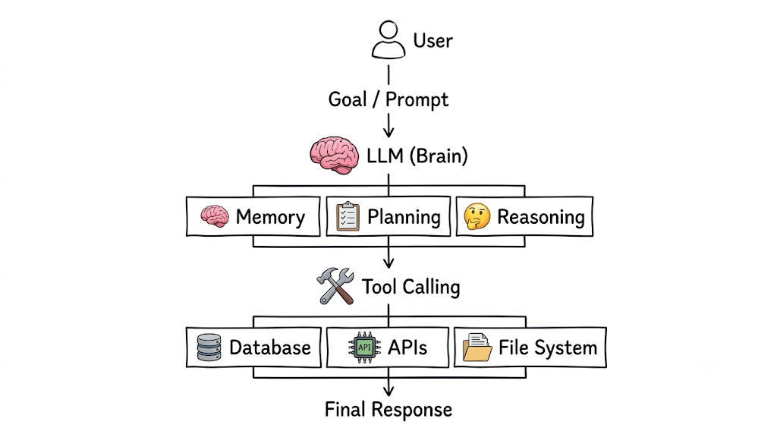
AI Agent Architecture
An LLM is the Brain. Memory, Planning, and Tools make it an AI Agent.

Slide 9
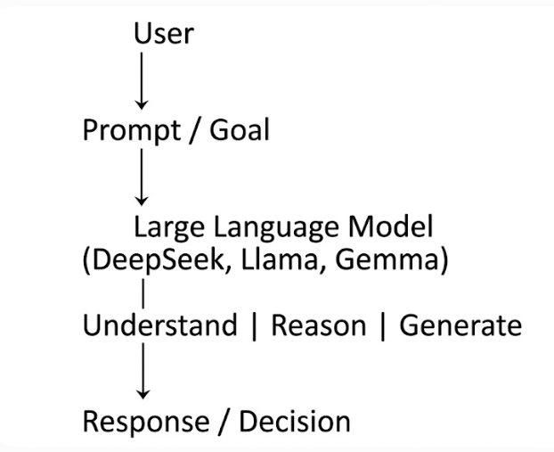
The Brain of an AI Agent – Large Language Model (LLM)
What Does an LLM Do?
Understands Natural Language
Interprets user requests in plain English.
Reasons About Problems
Breaks complex tasks into logical steps.
Generates Content
Text
Code
SQL
Emails
Documentation
Decides the Next Action
Chooses whether to answer directly or invoke a tool (when used within an AI Agent).
The LLM provides intelligence. The AI Agent provides execution.

Slide 10
How AI Agents Think: Reasoning & Planning
Goal:
"Plan a 3-day trip to Ooty within ₹15,000."
Goal Received
Understand the Goal
Break into Tasks
• Find transport • Find hotels • Estimate budget • Plan itinerary
Use Tools
Generate Final Plan
Collect Information

Slide 11
How AI Agents Think: Reasoning & Planning
Human vs AI Agent
Human | AI Agent
Thinks before acting | Reasons before acting
Makes a plan | Creates a task plan
Uses resources | Uses tools/APIs
Checks progress | Evaluates results
Good AI Agents don't just answer. They reason, plan, and execute.

Slide 12
Demo: Build Your First AI Agent
Install Required Libraries
Outcome
By the end of this demo you will:
1 Create your first AI Agent
2 Understand LLM interaction
3 Execute Python code
What We Will Build
Connect to an LLM
Send a Prompt
Receive Response
Build First AI Agent
LIVE CODING SESSION
From this point onward, you'll write code along with me.

